Slide 1
E-Commerce Revenue &
Profitability Intelligence
Week 6 Final Data Analytics Project
Aastha Mehta | B.Tech Artificial Intelligence & Data Science
Aastha Mehta • Week 6 Final Data Analytics Project 1

Slide 2
Problem Statement & Objectives
Problem Statement
Objectives
• Raw e-commerce data can contain missing, duplicate and invalid records.
• Without preparation and analysis, revenue and profitability drivers are difficult to identify.
• Returns may create hidden profitability leakage even when sales appear strong.
• Prepare and validate the business dataset.
• Perform EDA, statistics and visualization.
• Analyse revenue, profit, returns and channels.
• Build an interactive Power BI dashboard.
• Generate data-driven recommendations.
Aastha Mehta • Week 6 Final Data Analytics Project 2

Slide 3
Dataset & Data Preparation
Realistic synthetic e-commerce dataset generated using Python
Raw records
Attributes
Cleaned records
2,510
26
2,477
• Identified missing customer, city, payment and discount values.
• Removed duplicates, invalid quantities/prices/discounts and future-dated records.
• Recalculated profit margin using valid net revenue.
• Final validation: 0 missing values and 0 duplicate records.
Aastha Mehta • Week 6 Final Data Analytics Project 3

Slide 4
Exploratory Data Analysis
From transactions to business performance
Net Revenue
Total Profit
Return Rate
₹92.15 lakh
₹26.16 lakh
7.11%
• West region was the strongest regional contributor.
• Electronics led the categories in revenue and profit.
• Website was the strongest sales channel.
• Returns emerged as a major profitability concern.
Aastha Mehta • Week 6 Final Data Analytics Project 4

Slide 5
Revenue & Profitability Analysis
Top Region — West
Top Channel — Website
• Net Revenue: ₹31.58 lakh
• Profit: ₹8.92 lakh
• Highest regional revenue and profit.
• Can serve as a benchmark for other regions.
• Net Revenue: ₹41.04 lakh
• Profit: ₹12.30 lakh
• Profit Margin: 29.98%
• Strongest overall sales-channel performance.
Aastha Mehta • Week 6 Final Data Analytics Project 5

Slide 6
Return & Profit Leakage Analysis
Returned orders
Return rate
Profit impact
176
7.11%
−₹3.07 lakh
• Returned orders generated approximately −₹3.07 lakh in profit.
• Home & Kitchen had the highest return rate: 8.91%.
• Home & Kitchen also had the largest return-related profit loss: approximately ₹1.08 lakh.
• Reducing returns can improve profitability without relying only on additional sales.
Aastha Mehta • Week 6 Final Data Analytics Project 6

Slide 7
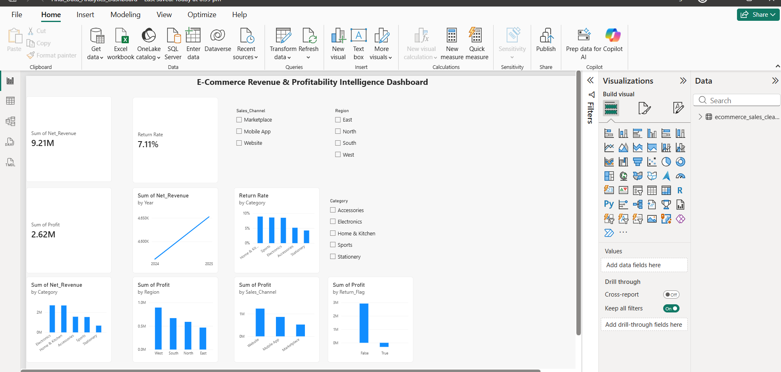
Power BI Dashboard
Interactive business intelligence view
E-Commerce Revenue & Profitability Intelligence Dashboard
• 3 KPI cards: Net Revenue, Total Profit, Return Rate
• 7 analytical visualizations
• 3 interactive slicers: Region, Sales Channel, Category
Replace this area with your full Power BI dashboard screenshot if desired.
Aastha Mehta • Week 6 Final Data Analytics Project 7

Slide 8
Business Insights & Recommendations
Key Insights
Recommendations
• West is the strongest region.
• Electronics leads revenue and profit.
• Returns cause significant profit leakage.
• Home & Kitchen has the highest return risk.
• Website is the strongest channel.
• Marketplace has the lowest margin.
• Investigate return reasons, quality, packaging and fulfilment in Home & Kitchen and Electronics.
• Strengthen the Website channel while reviewing Marketplace pricing, fees and customer experience.
• Investigate North region's 8.01% return rate and benchmark successful West-region practices.
Aastha Mehta • Week 6 Final Data Analytics Project 8

Slide 9
Conclusion
• The project demonstrates an end-to-end data analytics workflow from data preparation to business intelligence.
• The analysis identified major revenue and profit drivers across categories, regions and sales channels.
• Product returns were identified as a significant source of profitability leakage.
• The Power BI dashboard converts analytical results into an interactive decision-support view.
• Data-driven actions can help reduce returns, improve channel efficiency and strengthen profitability.
Thank You
Aastha Mehta • Week 6 Final Data Analytics Project 9

